Slide 1
A PRESENTATION ON DIGITAL COMPUTER ORGANISATION BY – AJITESH MISHRA

Slide 2
UNIT 1

Slide 3
INTRODUCTION TO COMPUTER ORGANISATION AND ARCHITECTURE
In order to achieve complete understandings of computer systems, it is always important to consider both hardware and software design of various computer components. In other words, every functionality of the computer has to be studied to increase the performance of the computer.
Computer organization and architecture mainly focuses on various parts of the computer in order to reduce the execution time of the program, improve the performance of each part. Generally, we tend to think computer organization and computer architecture as same but there is slight difference.

Slide 4
DIFFERENCE BETWEEN COMPUTER ARCHITECHTURE AND COMPUTER ORGANISATION
Computer Organization is study of the system from software point of view and gives overall description of the system and working principles without going into much detail. In other words, it is mainly about the programmer’s or user point of view.
Computer Architecture is study of the system from hardware point of view and emphasis on how the system is implemented. Basically, throws light on the designer’s point of view.

Slide 5
EXAMPLE
1. A chef prepares a certain recipe, then serves it to the customers. Chef knows how to prepare the food item whereas customer cares only about quality and taste of the food. In a same way, “chef” can referred to as computer architecture and “customer” as computer organization.
2. In a system, there are a set of instructions, it is enough for programmer or user to know what are a set of instructions present in case of computer organization whereas it is important for the system designer worries about how a set of instructions are implemented, algorithm of implementation is the emphasis in the case of architectural studies.

Slide 6
VON NEUMANN ARCHITECTURE
Von Neumann architecture was first published
by John von Neumann in 1945.
His computer architecture design consists of
a Control Unit, Arithmetic and Logic Unit (ALU),
Memory Unit, Registers and Inputs/Outputs.
Von Neumann architecture is based on the stored-
program computer concept, where instruction data
and program data are stored in the same
memory. This design is still used in most computers
produced today.

Slide 7
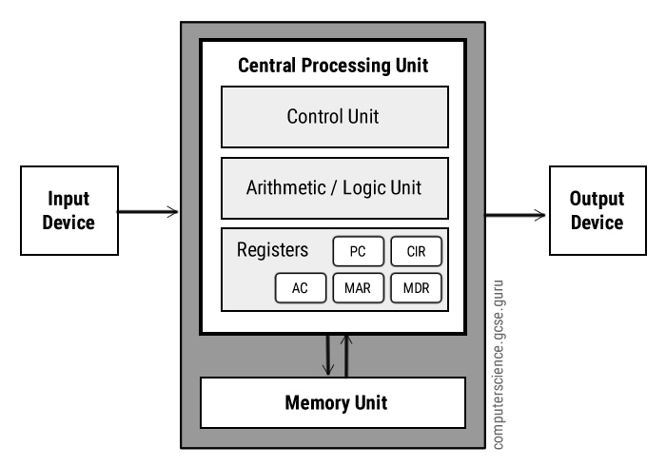
BLOCK DIAGRAM OF VON NEUMANN ARCHITECTURE

Slide 8
Central Processing Unit (CPU)
The Central Processing Unit (CPU) is the electronic circuit
responsible for executing the instructions of a computer
program. It is sometimes referred to as the
microprocessor or processor. The CPU contains the ALU, CU and
a variety of registers.
Control Unit (CU)
The control unit controls the operation of the computer’s ALU,
memory and input/output devices, telling them how to respond
to the program instructions it has just read and interpreted from
the memory unit.
The control unit also provides the timing and control signals
required by other computer components.

Slide 9
Registers
Registers are high speed storage areas in the CPU. All data must be stored in a register before it can be processed.
MAR (Memory Address Register)
Holds the memory location of data that needs to be accessed
MDR (Memory Data Register)
Holds data that is being transferred to or from memory
AC(Accumulator)
Where intermediate arithmetic and logic results are stored
PC (Program Counter)
Contains the address of the next instruction to be executed
CIR (Current Instruction Register)
Contains the current instruction during processing
Arithmetic and Logic Unit (ALU)
The ALU allows arithmetic (add, subtract etc) and logic (AND, OR, NOT etc) operations
to be carried out.

Slide 10
Memory Unit
The memory unit consists of RAM, sometimes referred to as primary or main memory. Unlike a hard drive (secondary memory), this memory is fast and also directly accessible by the CPU.
RAM is split into partitions. Each partition consists of an address and its contents (both in binary form).
The address will uniquely identify every location in the memory.
Loading data from permanent memory (hard drive), into the faster and directly accessible temporary memory (RAM), allows the CPU to operate much quicker.

Slide 11
INTERCONNECTION STRUCTURES
A computer consists of a set of components or modules of three basic types (processor, memory, I/O) that communicate with each other. In effect, a computer is a network of basic modules. Thus, there must be paths for connecting the modules. The collection of paths connecting the various modules is called the interconnection structure. The design of this structure will depend on the exchanges that must be made among modules. Figure in further slides suggests the types of exchanges that are needed by indicating the major forms of input and output for each module type.

Slide 12
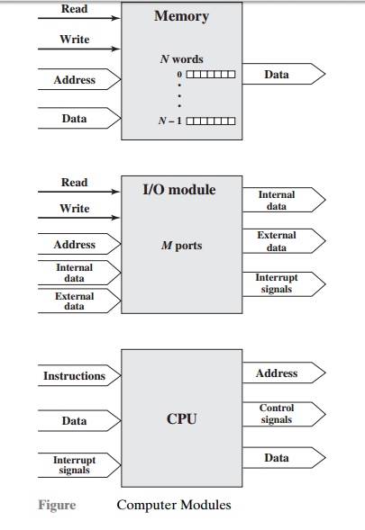

Slide 13
Memory:
Typically, a memory module will consist of N words of equal length. Each word is assigned a unique numerical address (0, 1, . . . , N – 1). A word of data can be read from or written into the memory. The nature of the operation is indicated by read and write control signals. The location for the operation is specified by an address.
I/O module:
From an internal (to the computer system) point of view, I/O is functionally similar to memory. There are two operations, read and write. Further, an I/O module may control more than one external device. We can refer to each of the interfaces to an external device as a port and give each a unique address (e.g., 0, 1,…, M – 1). In addition, there are external data paths for the input and output of data with an external device. Finally, an I/O module may be able to send interrupt signals to the processor.

Slide 14
Processor: The processor reads in instructions and data, writes out data after processing, and uses control signals to control the overall operation of the system. It also receives interrupt signals. The preceding list defines the data to be exchanged. The interconnection structure must support the following types of transfers:
• Memory to processor: The processor reads an instruction or a unit of data from memory. • Processor to memory: The processor writes a unit of data to memory. • I/O to processor:The processor reads data from an I/O device via an I/O module. • Processor to I/O: The processor sends data to the I/O device. • I/O to or from memory: For these two cases, an I/O module is allowed to exchange data directly with memory, without going through the processor, using direct memory access (DMA).
Though a number of interconnection structures have been tried. By far the most common is the bus and various multiple-bus structures. We will look bus structure in further slides..

Slide 15
BUS INTECONNECTION
A bus is a communication pathway connecting two or more devices. A key characteristic of a bus is that it is a shared transmission medium. Multiple devices connect to the bus, and a signal transmitted by any one device is available for reception by all other devices attached to the bus. If two devices transmit during the same time period, their signals will overlap and become garbled. Thus, only one device at a time can successfully transmit.
Typically, a bus consists of multiple communication pathways, or lines. Each line is capable of transmitting signals representing binary 1 and binary 0. Over time, a sequence of binary digits can be transmitted across a single line. Taken together, several lines of a bus can be used to transmit binary digits simultaneously (in parallel).
For example, an 8-bit unit of data can be transmitted over eight bus lines. Computer systems contain a number of different buses that provide pathways between components at various levels of the computer system hierarchy. A bus that connects major computer components (processor, memory, I/O) is called a system bus. The most common computer interconnection structures are based on the use of one or more system buses.
NOTE: A bus can also be called a line.

Slide 16
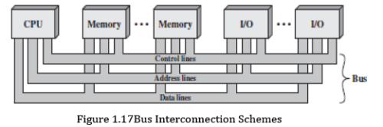
A system bus consists, typically, of from about 50 to hundreds of separate lines. Each line is assigned a particular meaning or function. Although there are many different bus designs, on any bus the lines can be classified into three functional groups : data, address, and control lines.

Slide 17
Data Bus
In addition, there may be power distribution lines that supply power to the attached modules. The data lines provide a path for moving data among system modules. These lines, collectively, are called the data bus. The data bus may consist of 32, 64, 128, or even more separate lines, the number of lines being referred to as the width of the data bus. Because each line can carry only 1 bit at a time, the number of lines determines how many bits can be transferred at a time. The width of the data bus is a key factor in determining overall system performance.
For example, if the data bus is 32 bits wide and each instruction is 64 bits long, then the processor must access the memory module twice during each instruction cycle.

Slide 18
Address Bus
The address lines are used to designate the source or destination of the data on the data bus. For example, if the processor wishes to read a word (8, 16, or 32 bits) of data from memory, it puts the address of the desired word on the address lines. Clearly, the width of the address bus determines the maximum possible memory
capacity of the system. Furthermore, the address lines are generally also used to address I/O ports. Typically, the higher-order bits are used to select a particular module on the bus, and the lower-order bits select a memory location or I/O port within the module. For example, on an 8-bit address bus, address 01111111 and below might reference locations in a memory module (module 0) with 128 words of memory, and address 10000000 and above refer to devices attached to an I/O module (module 1).

Slide 19
Control Bus
The control lines are used to control the access to and the use of the data and address lines. Because the data and address lines are shared by all components, there must be a means of controlling their use. Control signals transmit both command and timing information among system modules. Timing signals indicate the validity of data and address information. Command signals specify operations to be performed.
Typical control lines include:
• Memory write: Causes data on the bus to be written into the addressed location. • Memory read: Causes data from the addressed location to be placed on the bus. • I/O write: Causes data on the bus to be output to the addressed I/O port. • I/O read: Causes data from the addressed I/O port to be placed on the bus. • Transfer ACK: Indicates that data have been accepted from or placed on the bus. • Bus request: Indicates that a module needs to gain control of the bus. • Bus grant: Indicates that a requesting module has been granted control of the bus • Interrupt request: Indicates that an interrupt is pending • Interrupt ACK: Acknowledges that the pending interrupt has been recognized • Clock: Is used to synchronize operations • Reset: Initializes all modules

Slide 20
Basic operation in Bus
The operation of the bus is as follows. If one module wishes to send data to another, it must do two things:
(1) obtain the use of the bus, and
(2) transfer data via the bus.
If one module wishes to request data from another module, it must
(1)obtain the use of the bus, and
(2) transfer a request to the other module over the appropriate control and address lines. It must then wait for that second module to send the data. Physically, the system bus is actually a number of parallel electrical conductors. In the classic bus arrangement, these conductors are metal lines etched in a card or board (printed circuit board). The bus extends across all of the system components, each of which taps into some or all of the bus lines.

Slide 21
UNIT 2

Slide 22
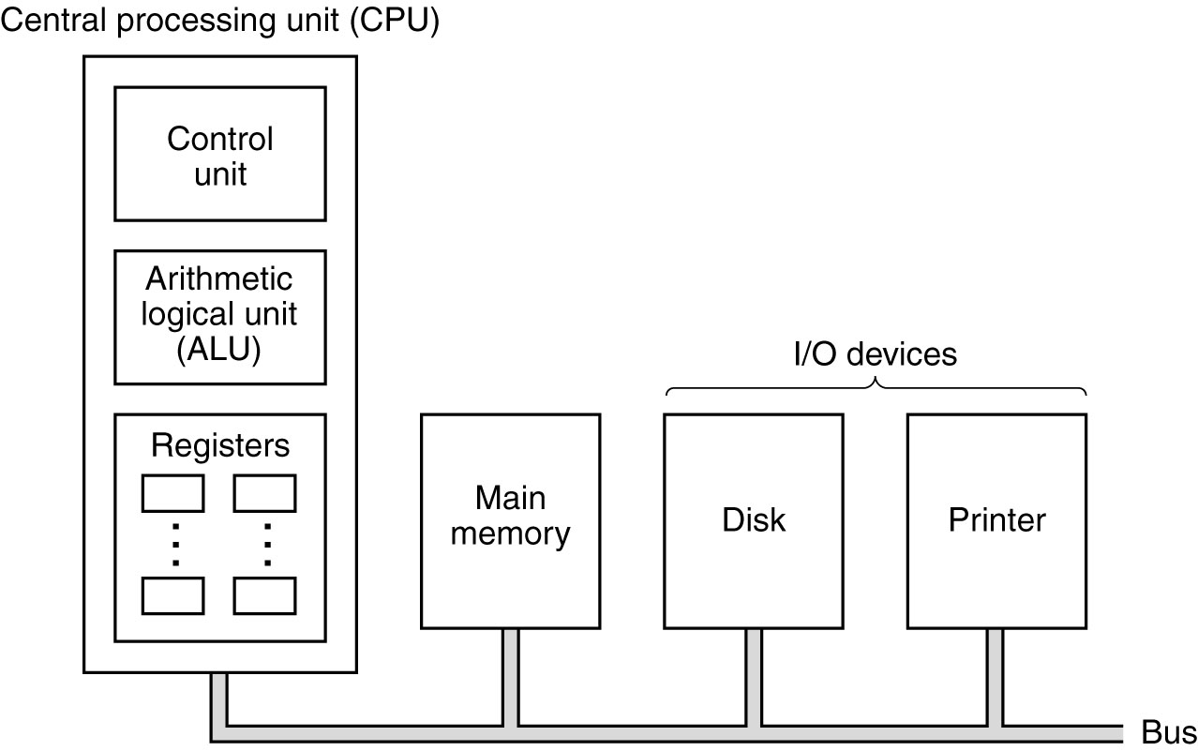
Central Processing Unit
The organization of a simple computer with one CPU and two I/O devices

Slide 23
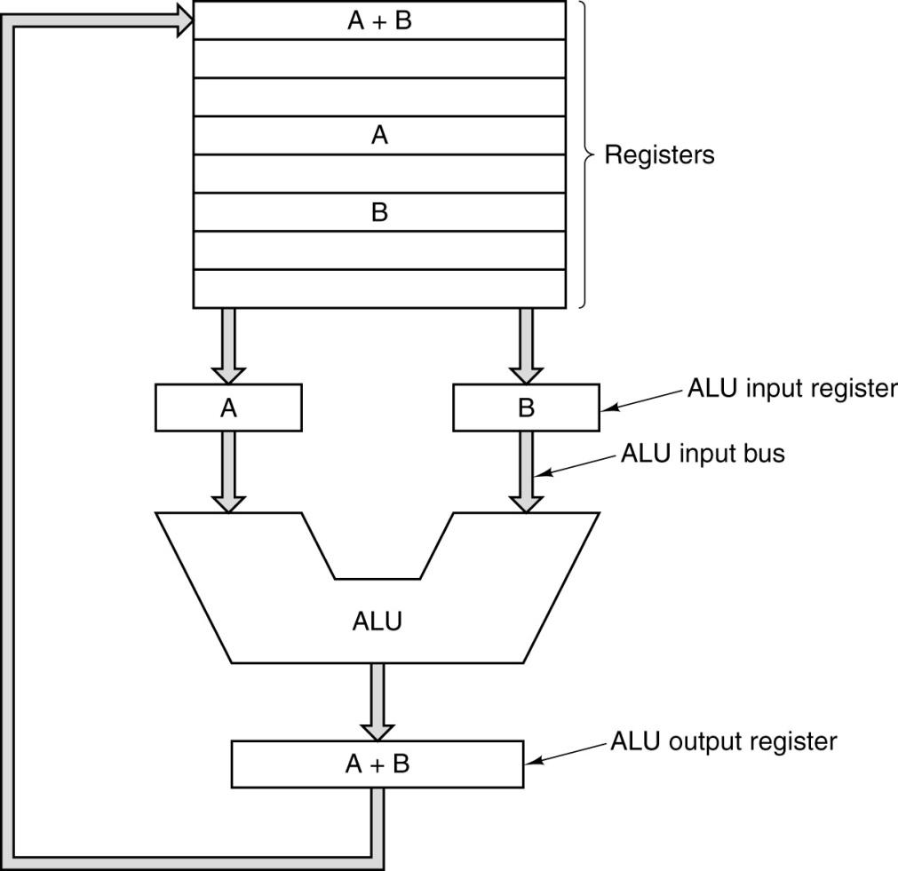
CPU Organization
The data path of a typical Von Neumann machine.

Slide 24
Instruction Execution Steps
Fetch next instruction from memory into instr. register
Change program counter to point to next instruction
Determine type of instruction just fetched
If instructions uses word in memory, determine where Fetch word, if needed, into CPU register
Execute the instruction
Go to step 1 to begin executing following instruction

Slide 25
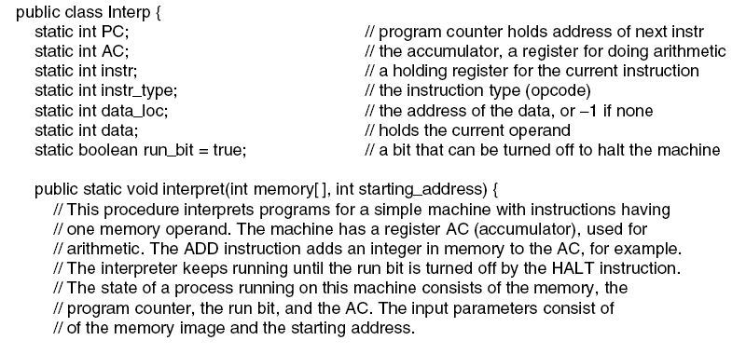
Interpreter (1)
. . .
An interpreter for a simple computer (written in Java).

Slide 26
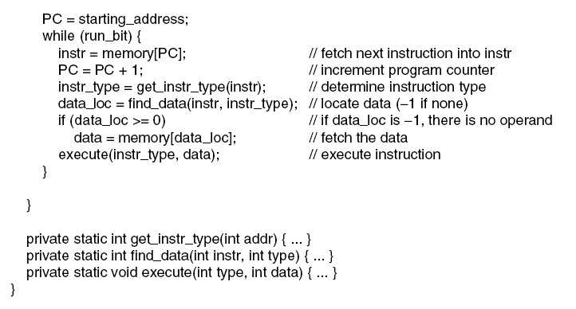
Interpreter (2)
An interpreter for a simple computer (written in Java).

Slide 27
Design Principles for Modern Computers
All instructions directly executed by hardware
Maximize rate at which instructions are issued
Instructions should be easy to decode
Only loads, stores should reference memory
Provide plenty of registers

Slide 28
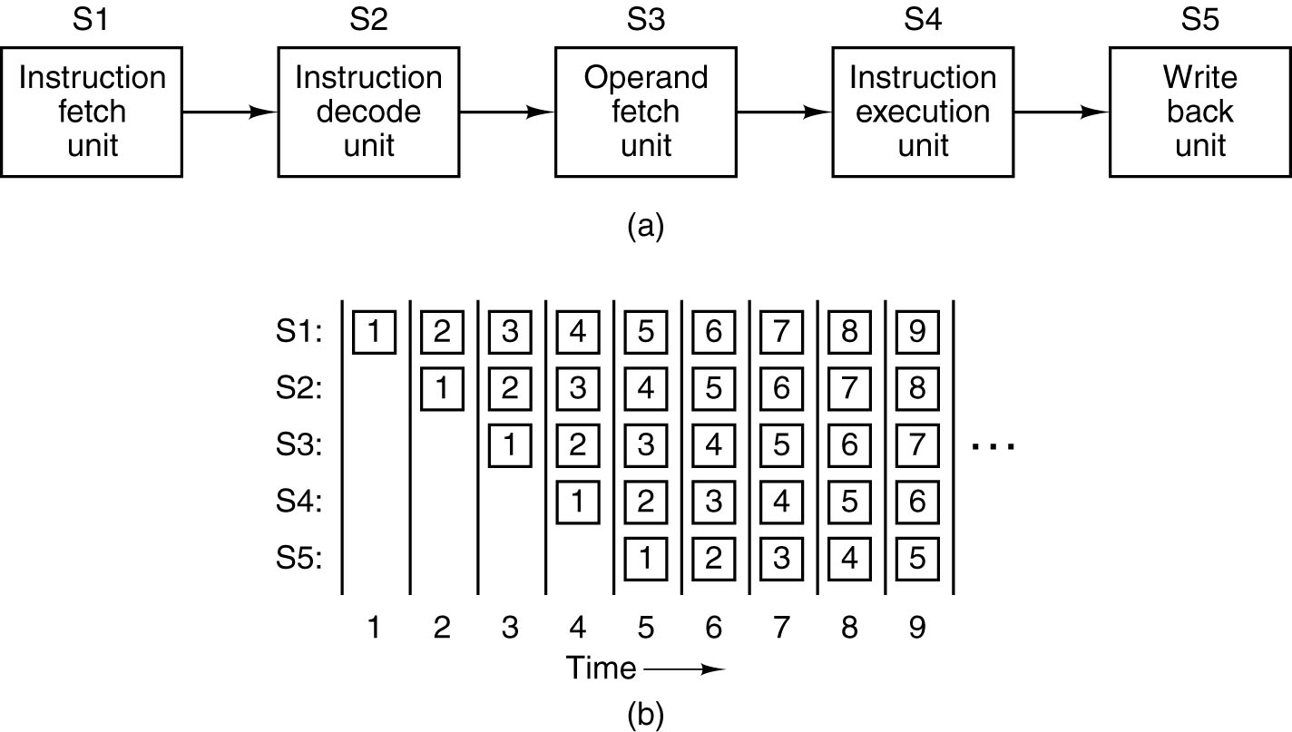
Instruction-Level Parallelism
A five-stage pipeline
The state of each stage as a function of time. Nine clock cycles are illustrated

Slide 29
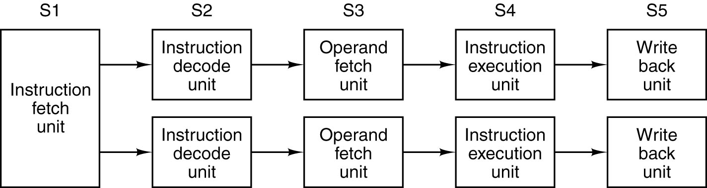
Superscalar Architectures (1)
Dual five-stage pipelines with a common instruction fetch unit.

Slide 30
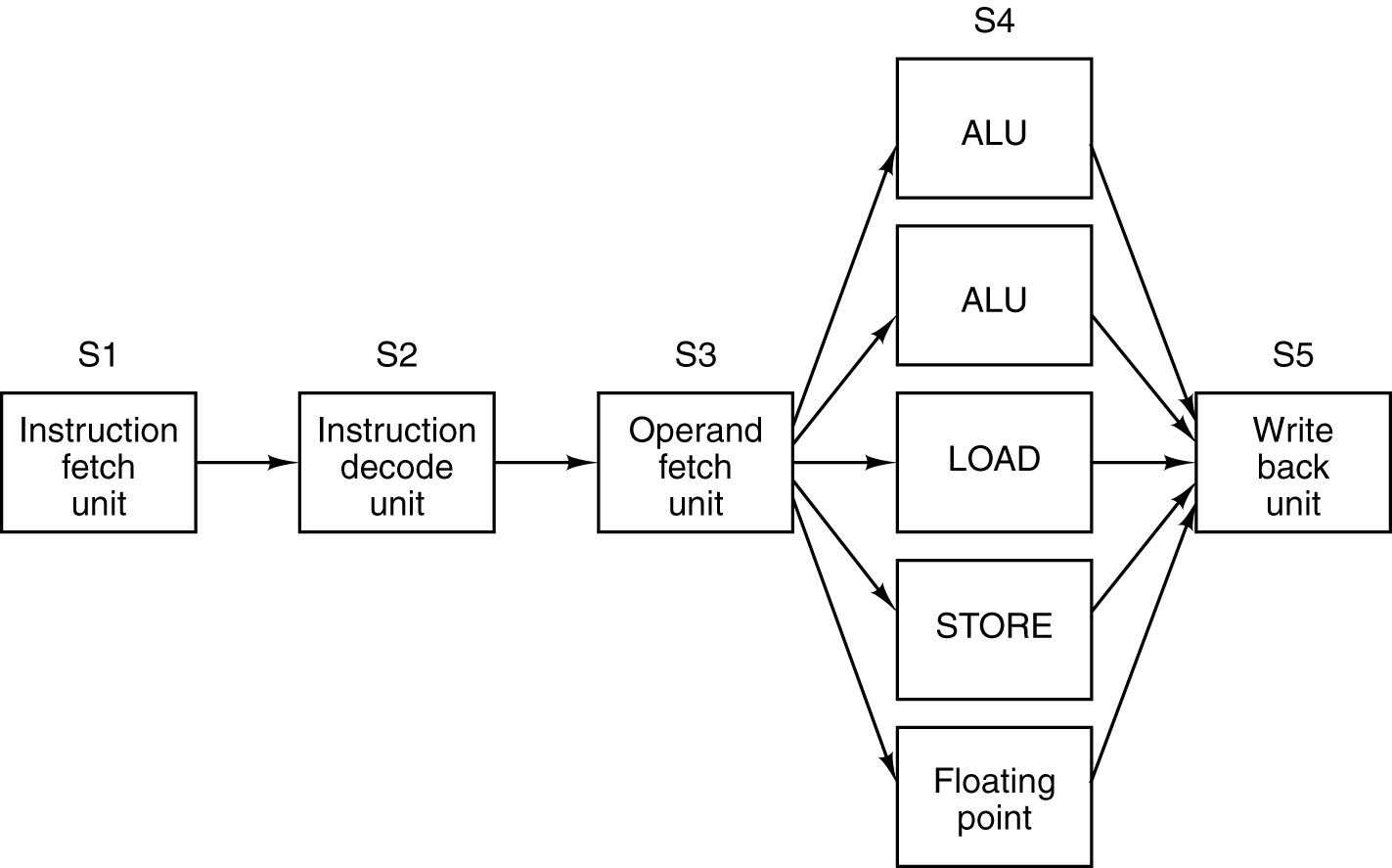
Superscalar Architectures (2)
A superscalar processor with five functional units.

Slide 31
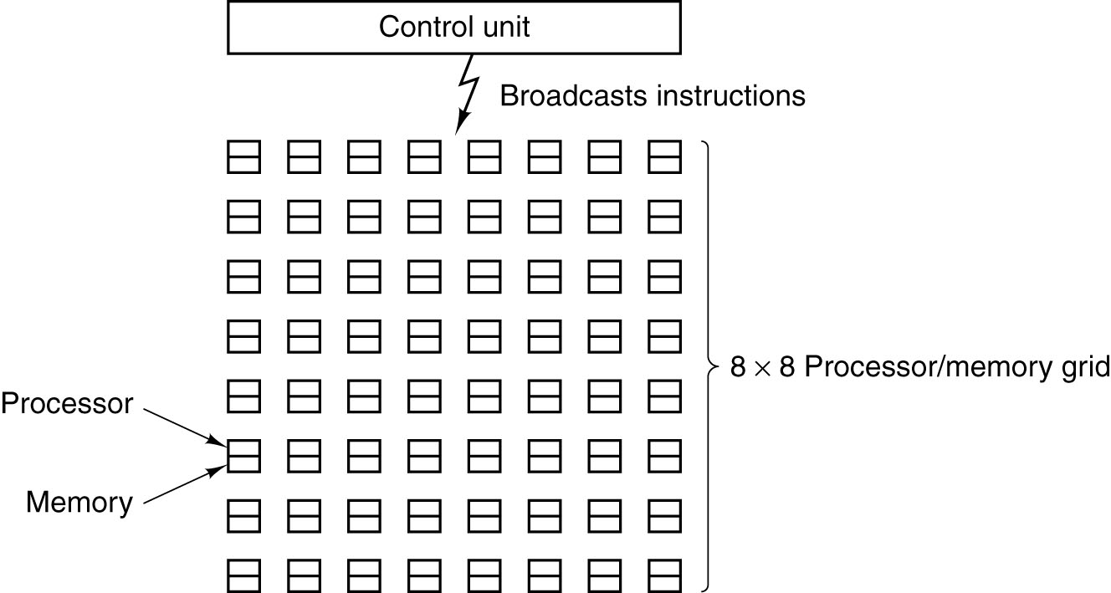
Processor-Level Parallelism (1)
An array of processor of the ILLIAC IV type.

Slide 32
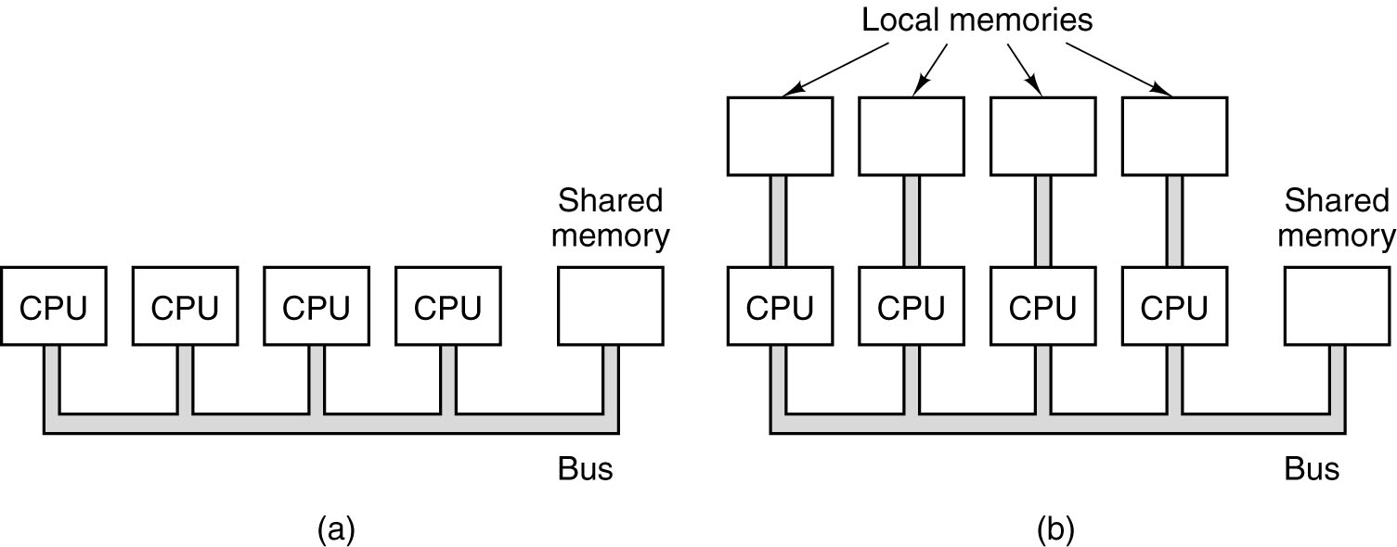
Processor-Level Parallelism (2)
A single-bus multiprocessor.
A multicomputer with local memories.

Slide 33
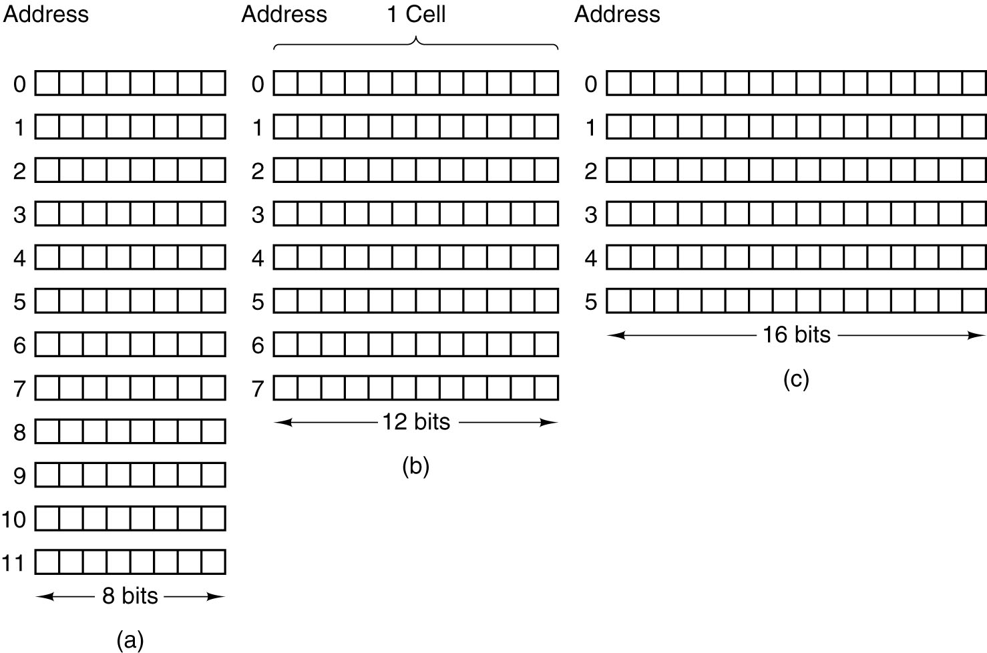
Primary Memory Memory Addresses (1)
Three ways of organizing a 96-bit memory.

Slide 34
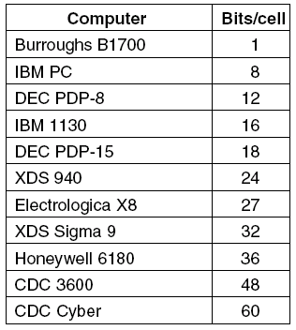
Primary Memory Memory Addresses (2)
Number of bits per cell for some historically interesting commercial computers

Slide 35
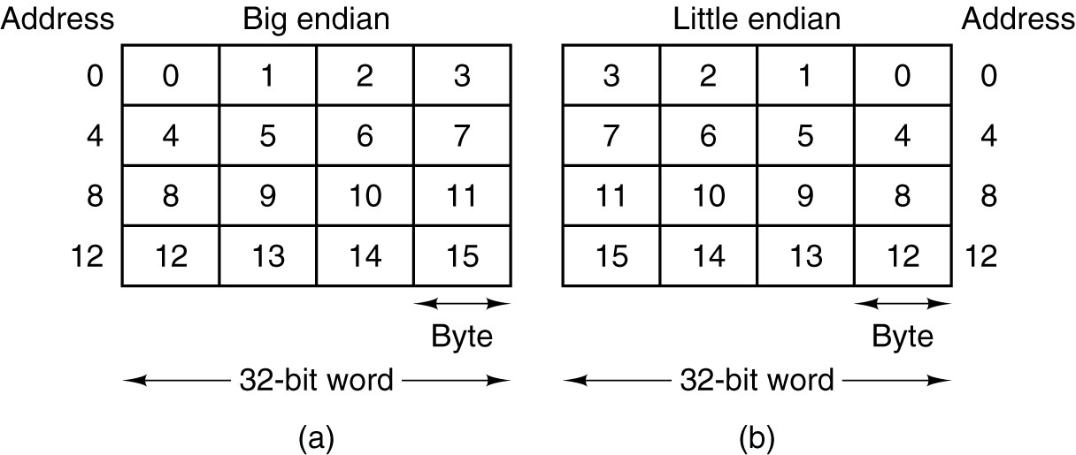
Byte Ordering (1)
(a) Big endian memory (b) Little endian memory

Slide 36
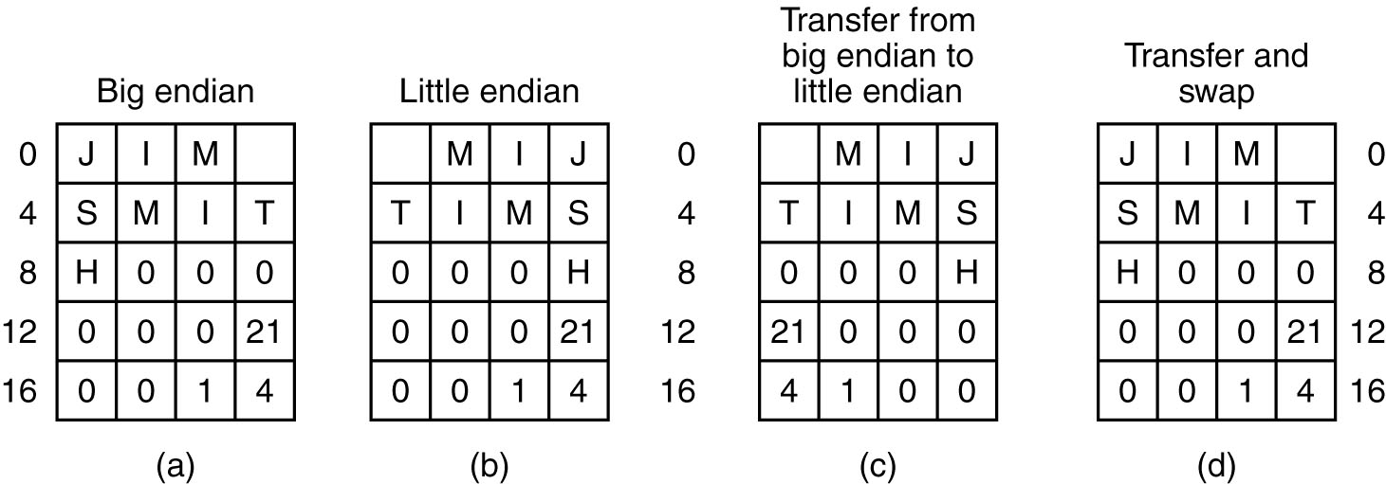
Byte Ordering (2)
(a) A personal record for a big endian machine.
(b) The same record for a little endian machine.
(c) The result of transferring from big endian to little endian.
(d) The result of byte-swapping (c).

Slide 37
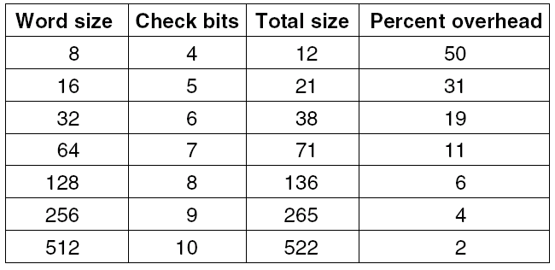
Error Correcting Codes (1)
Number of check bits for a code that can correct a single error

Slide 38
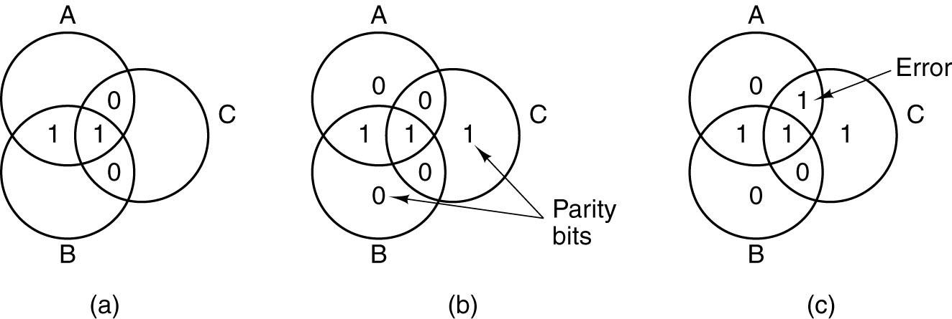
Error Correcting Codes (2)
(a) Encoding of 1100
(b) Even parity added
(c) Error in AC

Slide 39
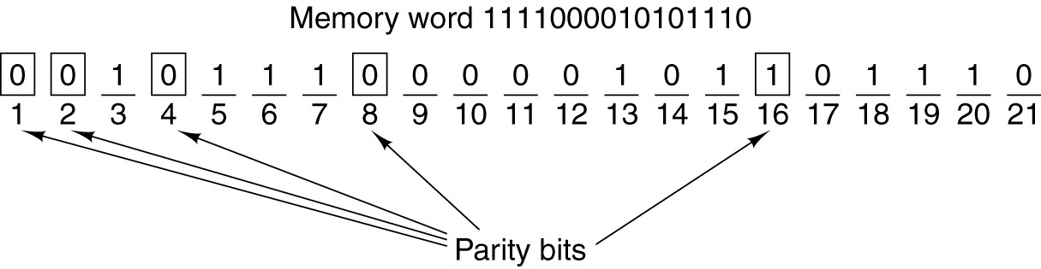
Error Correcting Codes (3)
Construction of the Hamming code for the memory word 11110000010101110 by adding 5 check bits to the 16 data bits.

Slide 40
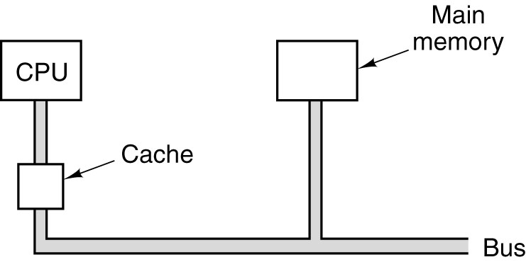
Cache Memory
The cache is logically between the CPU and main memory. Physically, there are several possible places it could be located.

Slide 41
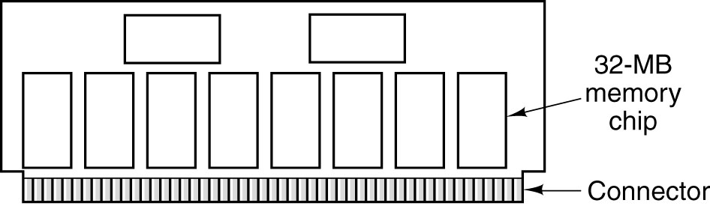
Memory Packaging and Types
A single inline memory module (SIMM) holding 256 MB. Two of the chips control the SIMM.

Slide 42
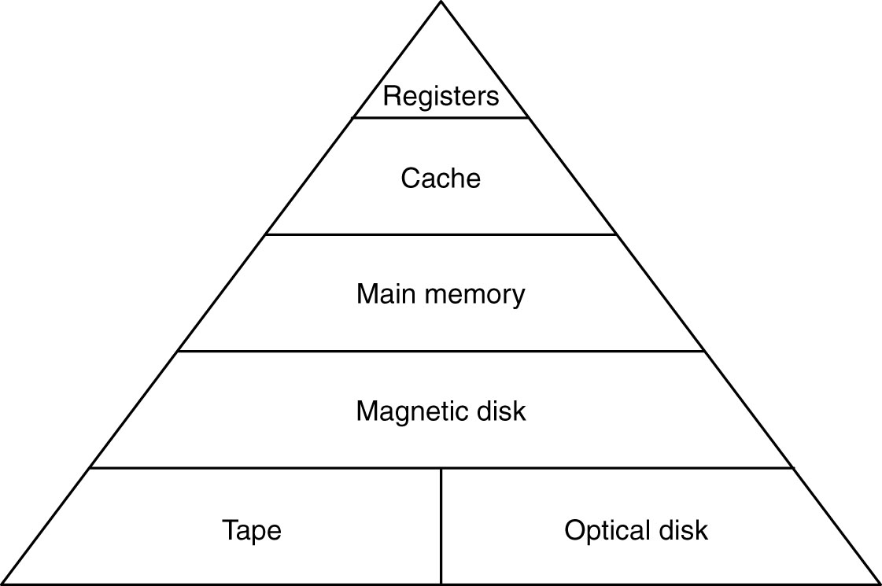
Memory Hierarchies
A five-level memory hierarchy.

Slide 43
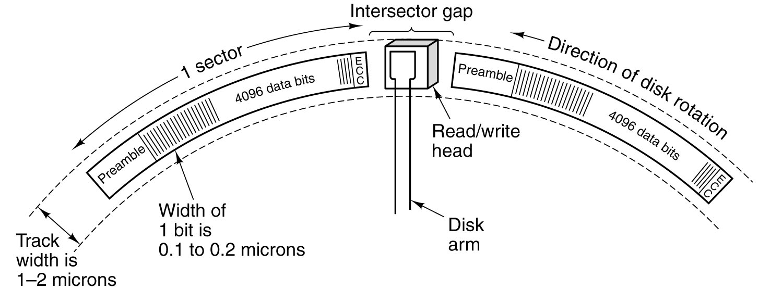
Magnetic Disks (1)
A portion of a disk track. Two sectors are illustrated.

Slide 44
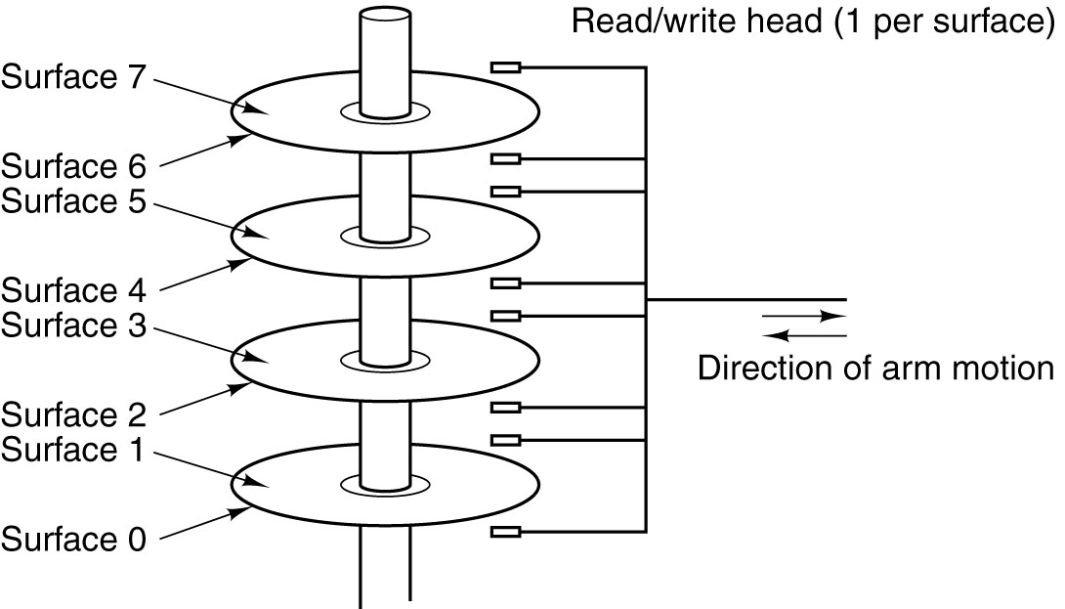
Magnetic Disks (2)
A disk with four platters.

Slide 45
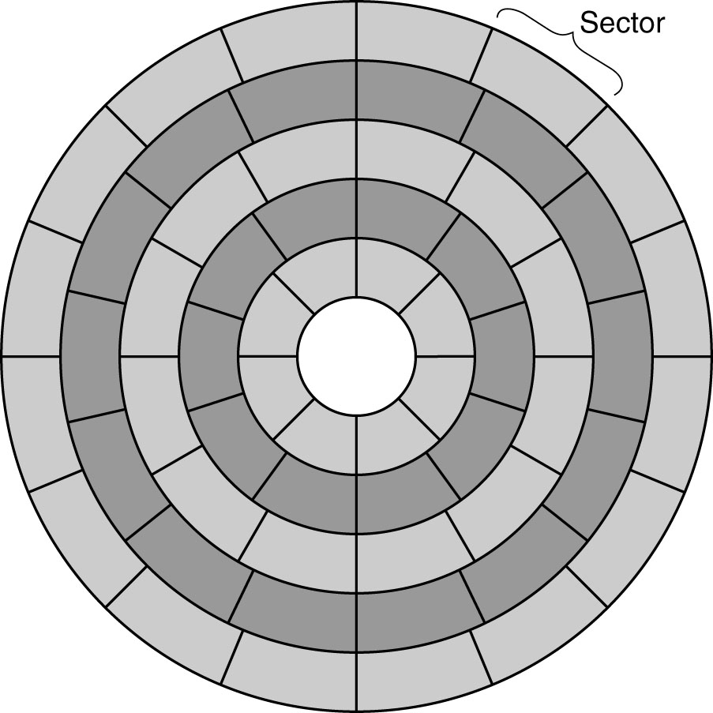
Magnetic Disks (3)
A disk with five zones. Each zone has many tracks.

Slide 46
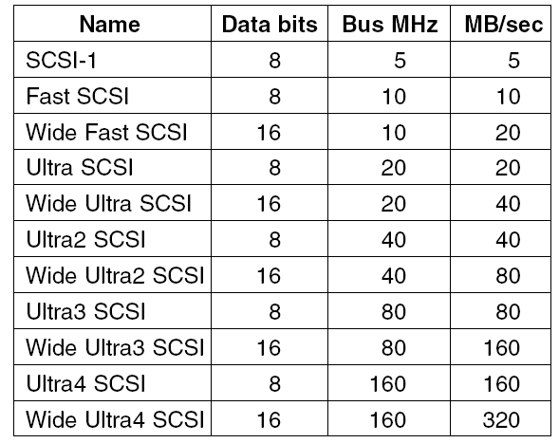
SCSI Disks
Some of the possible SCSI parameters.

Slide 47
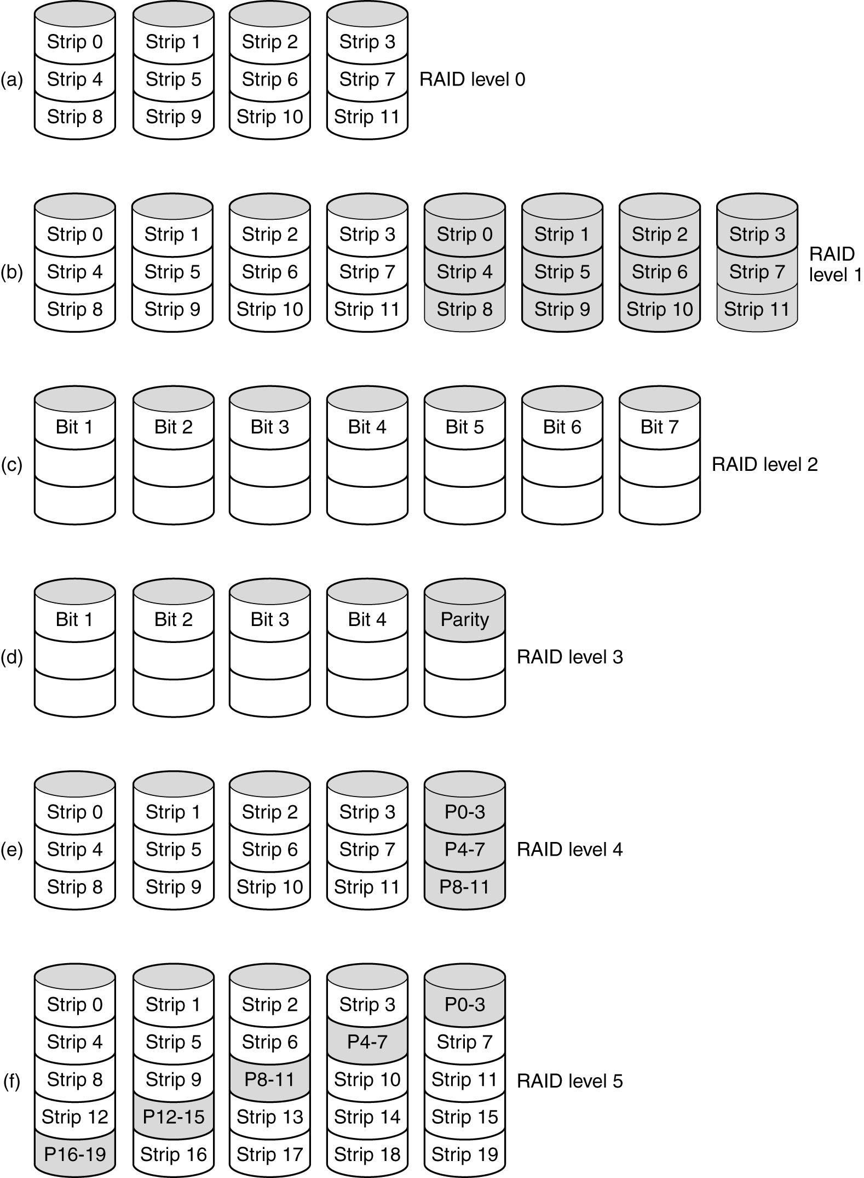
RAID (1) Redundant Array of Inexpensive Disks
RAID levels 0 through 2.
Backup and parity disks are shown shaded.

Slide 48
RAID (1) Redundant Array of Inexpensive Disks
RAID levels 3 through 5. Backup and parity disks are shown shaded.

Slide 49
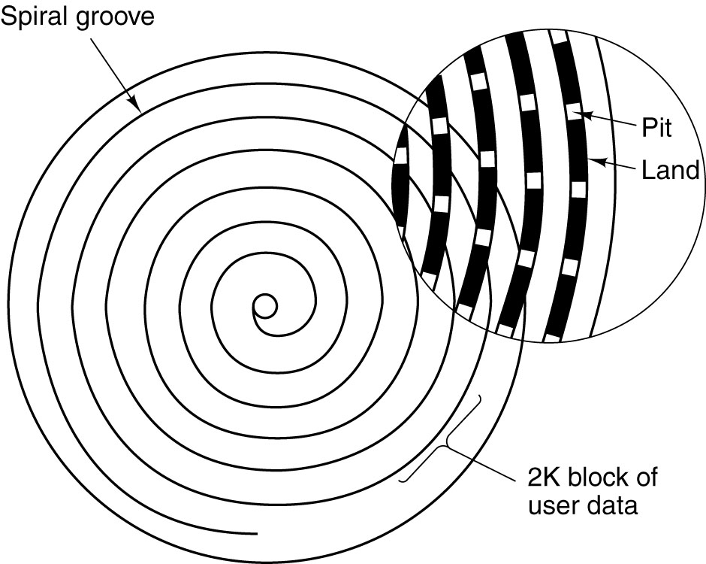
CD-ROMs (1)
Recording structure of a Compact Disk or CD-ROM.

Slide 50
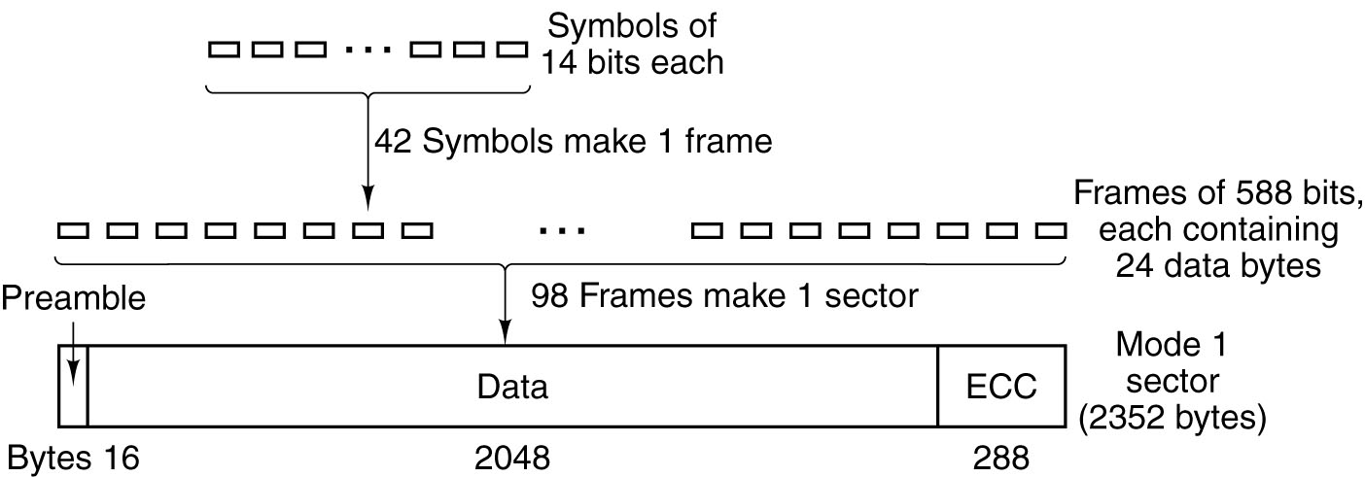
CD-ROMs (2)
Logical data layout on a CD-ROM.

Slide 51
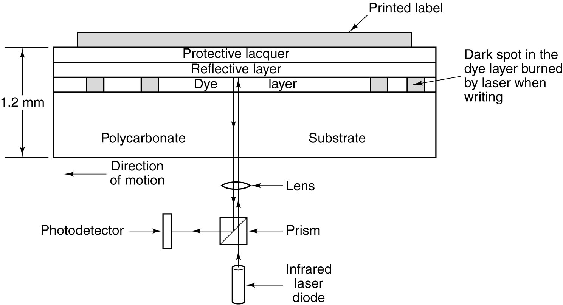
CD-Recordables
Cross section of a CD-R disk and laser (not to scale). A CD-ROM has a similar structure, except without the dye layer and with a pitted aluminum layer instead of a reflective layer.

Slide 52
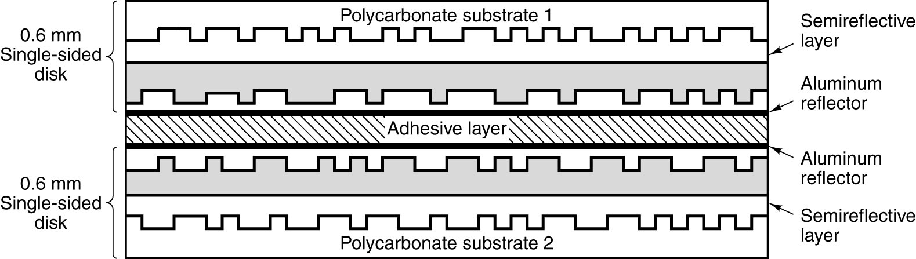
DVD
A double-sided, dual layer DVD disk.

Slide 53
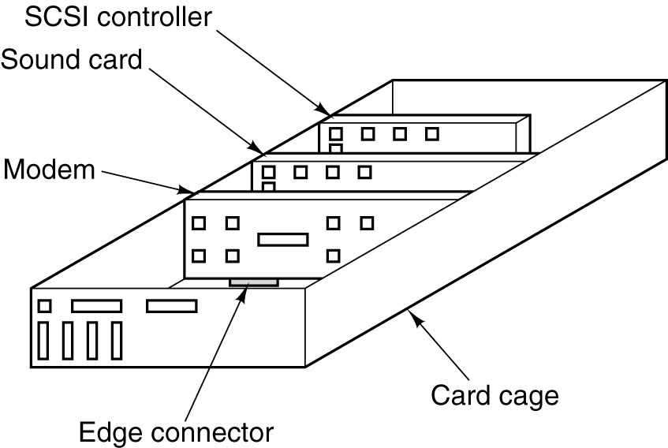
Input/Output Buses (1)
Physical structure of a personal computer.

Slide 54
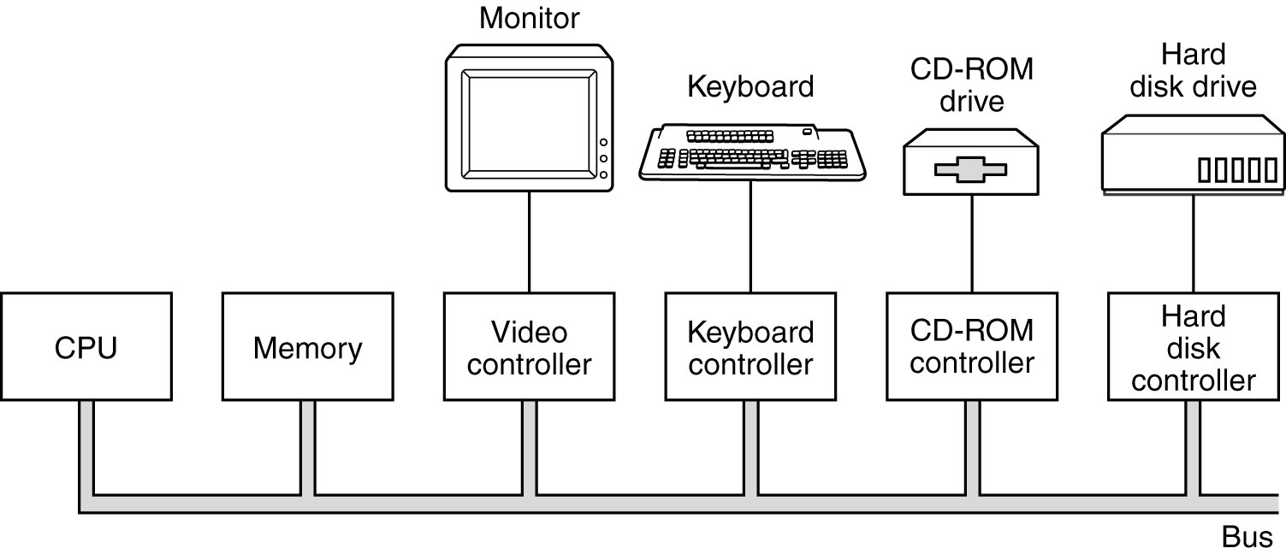
Input/Output Buses (2)
Logical structure of a simple personal computer.

Slide 55
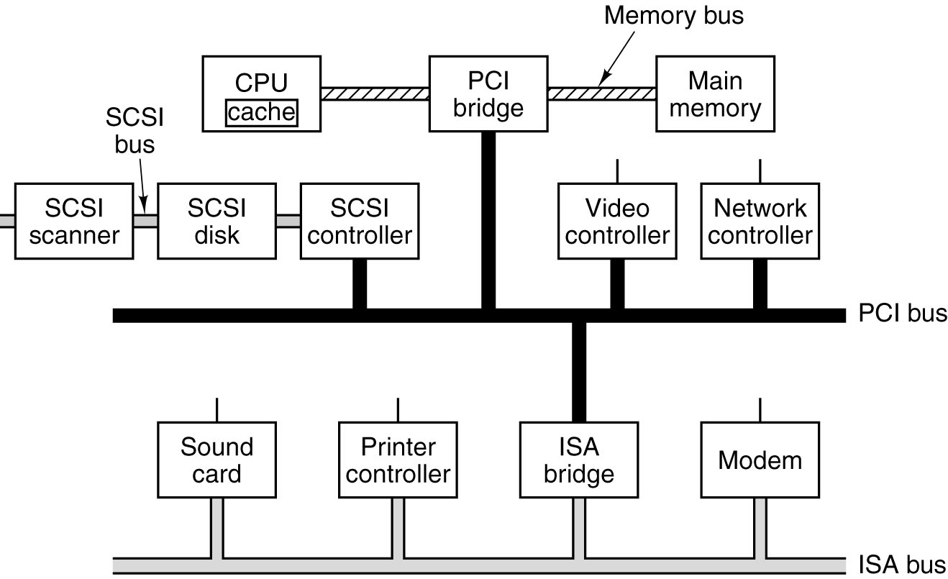
Input/Output Buses (3)
A typical modern PC with a PCI bus and an ISA bus.

Slide 56
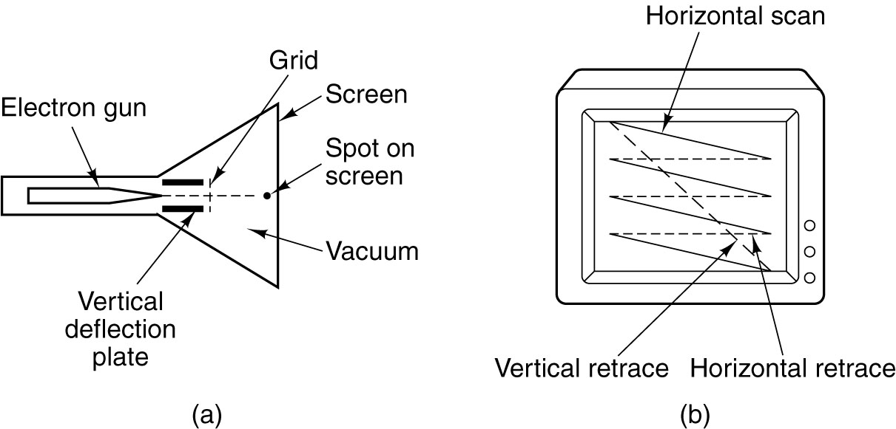
CRT Monitors
(a) Cross section of a CRT
(b) CRT scanning pattern

Slide 57
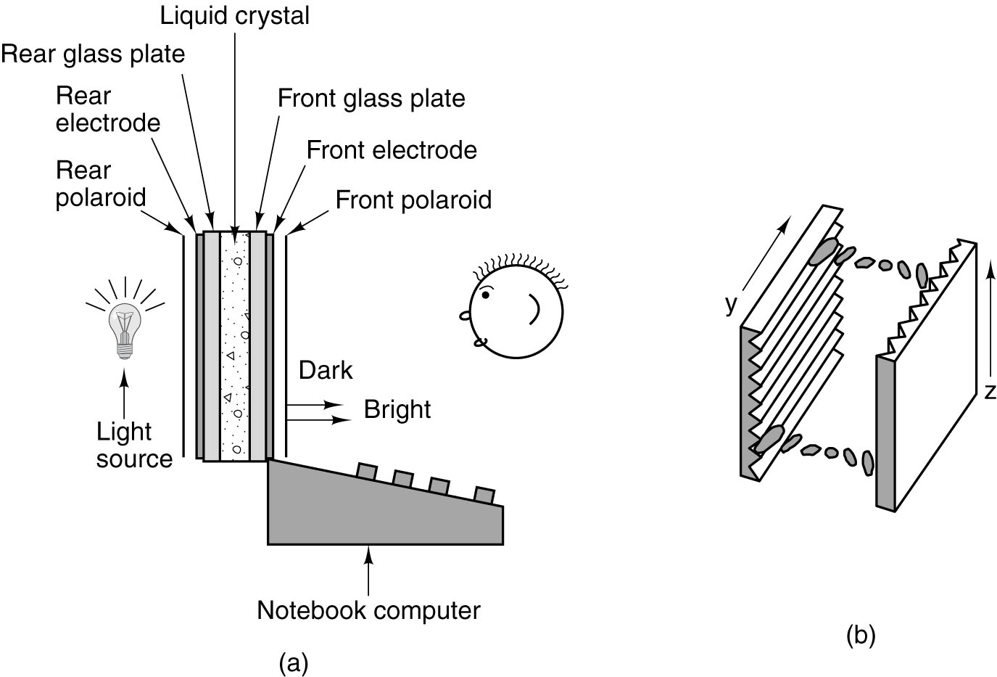
Flat Panel Displays
(a) The construction of an LCD screen.
(b) The grooves on the rear and front plates are perpendicular to one another.

Slide 58
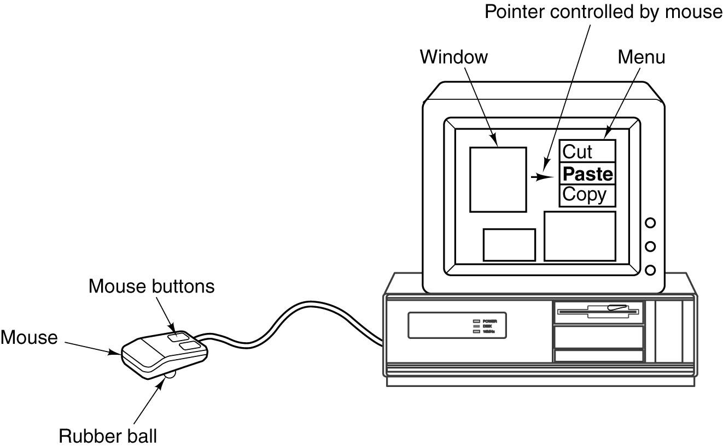
Mice
A mouse being used to point to menu items.

Slide 59
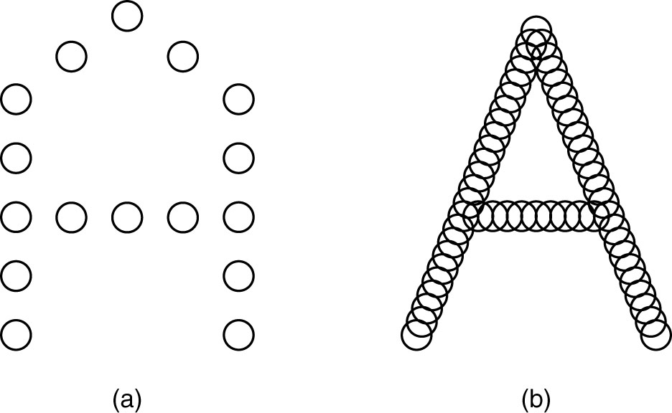
Printers (1)
(a) The letter “A” on a 5 x 7 matrix.
(b) The letter “A” printed with 24 overlapping needles.

Slide 60
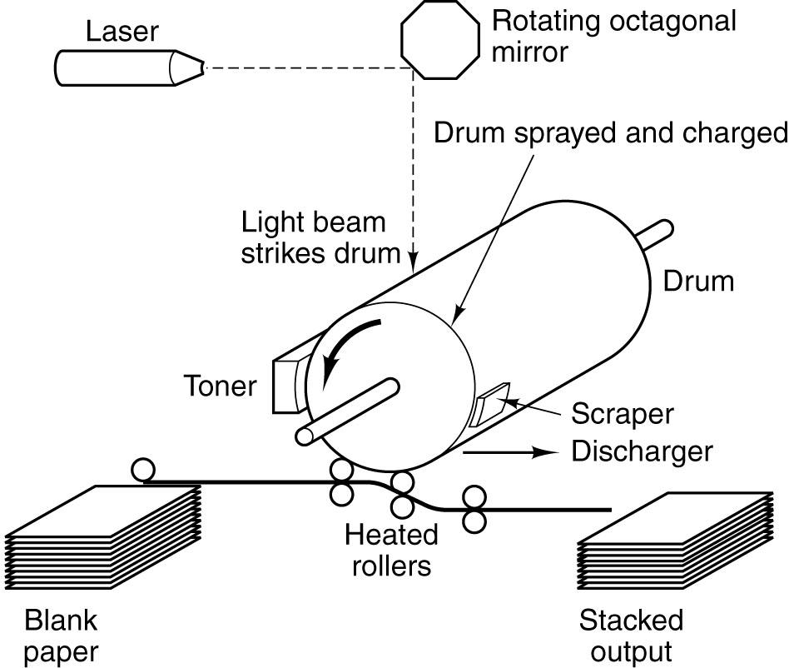
Printers (2)
Operation of a laser printer.

Slide 61
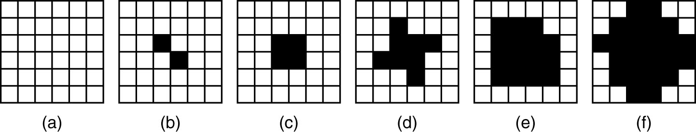
Printers (3)
Halftone dots for various gray scale ranges.
(a) 0 – 6. (b) 14 – 20. (c) 28 – 34.
(d) 56 – 62. (e) 105 – 111. (f) 161 – 167.

Slide 62
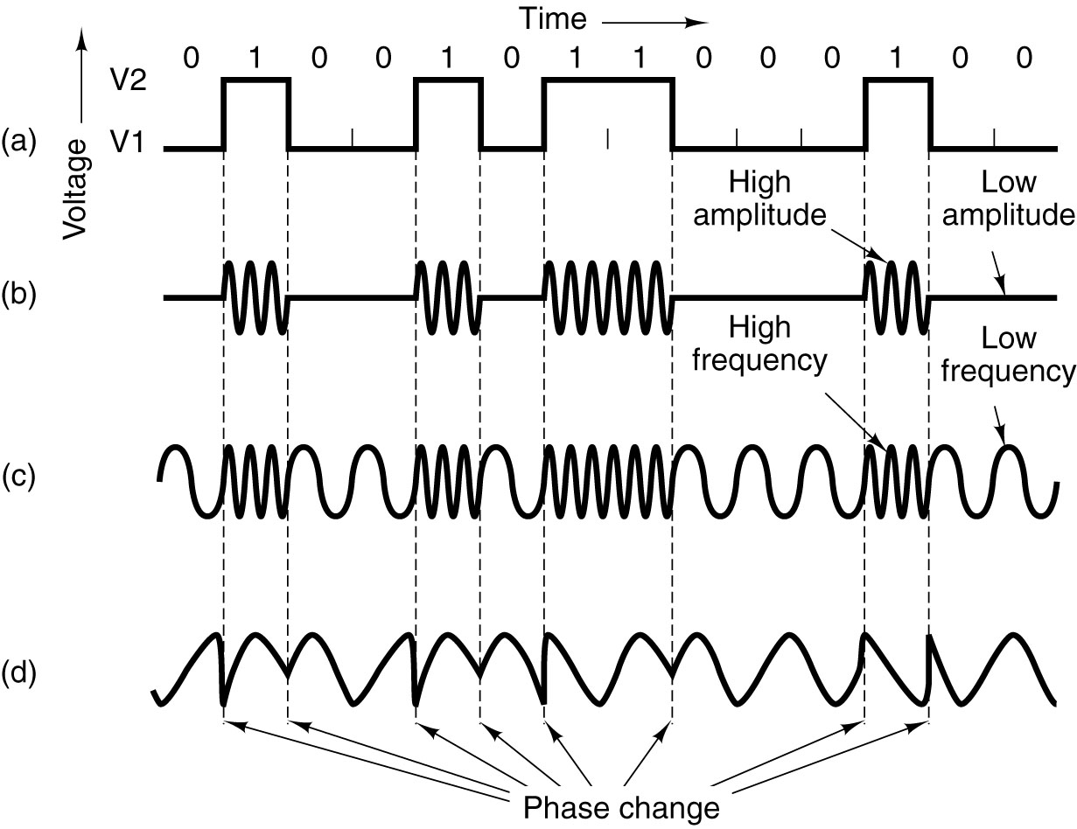
Telecommunications
Transmission of the binary number 01001010000100 over a
telephone line bit by bit. (a) Two-level signal. (b) Amplitude
modulation. (c) Frequency modulation. (d) Phase modulation.

Slide 63
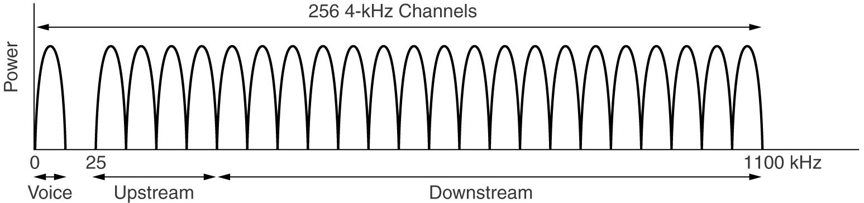
Digital Subscriber Lines (1)
Operation of ADSL.

Slide 64
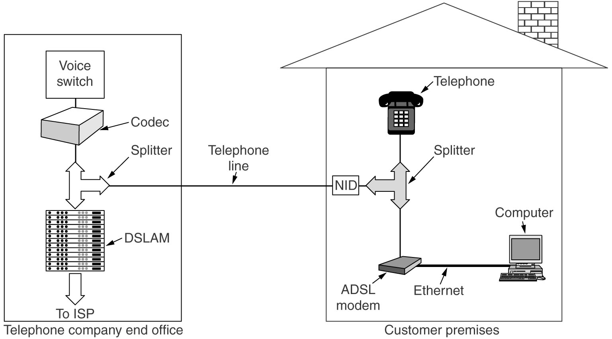
Digital Subscriber Lines (2)
A typical ADSL equipment configuration.

Slide 65
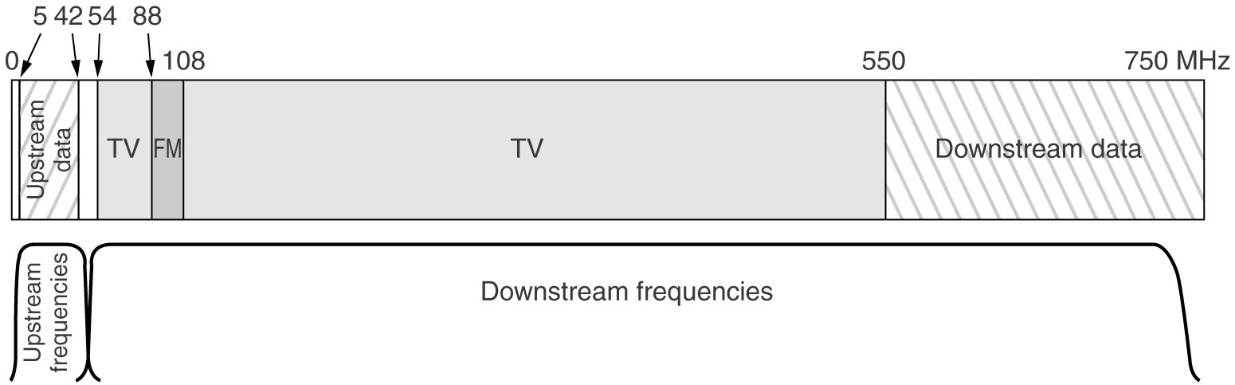
Internet over Cable (1)
Frequency allocation in a typical cable TV system used for Internet access

Slide 66
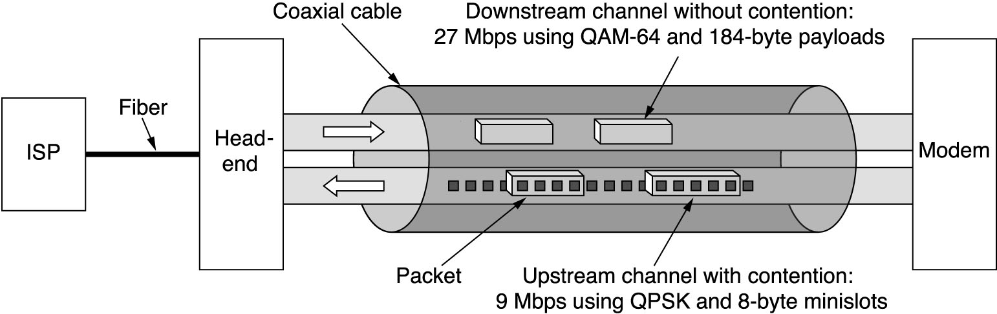
Internet over Cable (2)
Typical details of the upstream and downstream channels in North America. QAM-64 (Quadrature Amplitude Modulation) allows 6 bits/Hz but only works at high frequencies. QPSK (Quadrature Phase Shift Keying) works at low frequencies but allows only 2 bits/Hz.

Slide 67
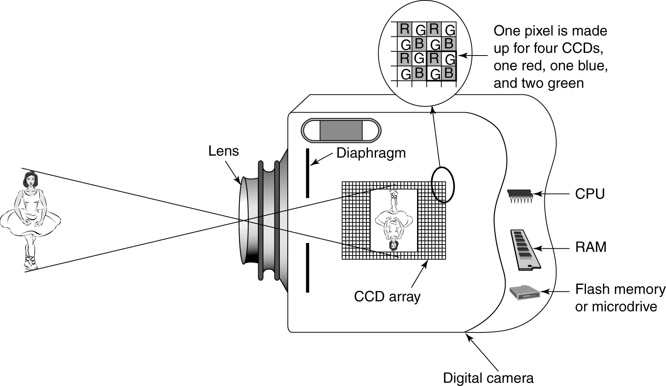
Digital Cameras
A digital camera.

Slide 68
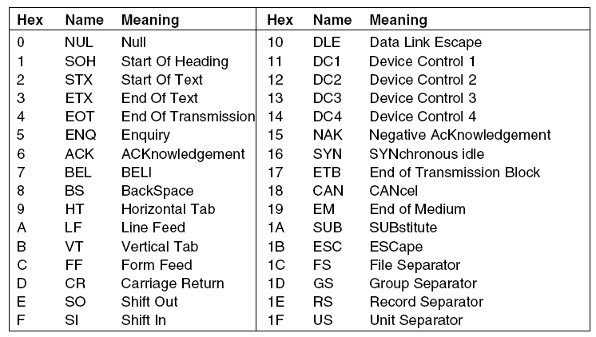
ASCII Character Codes (1)
The ASCII Character set: characters 0 – 31.

Slide 69
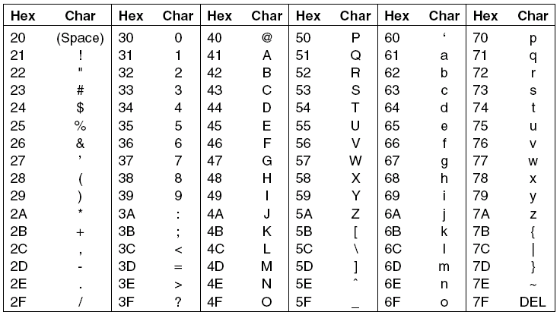
ASCII Character Codes (2)
The ASCII Character set: characters 32 – 127.

Slide 70
UNIT III

Slide 71
MEMORY HIERARCHY
INTRODUCTION
The memory in a computer can be divided into five hierarchies based on the speed as well as use. The processor can move from one level to another based on its requirements. The five hierarchies in the memory are registers, cache, main memory, magnetic discs, and magnetic tapes. The first three hierarchies are volatile memories which mean when there is no power, and then automatically they lose their stored data. Whereas the last two hierarchies are not volatile which means they store the data permanently.
A memory element is the set of storage devices which stores the binary data in the type of bits. In general, the storage of memory can be classified into two categories such as volatile as well as non- volatile

Slide 72
The memory hierarchy design in a computer system mainly includes different storage devices. Most of the computers were inbuilt with extra storage to run more powerfully beyond the main memory capacity. The following memory hierarchy diagram is a hierarchical pyramid for computer memory. The designing of the memory hierarchy is divided into two types such as primary (Internal) memory and secondary (External) memory.

Slide 73
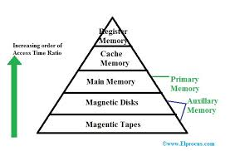
The memory hierarchy design in a computer system mainly includes different storage devices. Most of the computers were inbuilt with extra storage to run more powerfully beyond the main memory capacity. The following memory hierarchy diagram is a hierarchical pyramid for computer memory. The designing of the memory hierarchy is divided into two types such as primary (Internal) memory and secondary (External) memory.

Slide 74
Characterstics of Memory Hierarchy
The memory hierarchy characteristics mainly include the following:
Performance
Previously, the designing of a computer system was done without memory hierarchy, and the speed gap among the main memory as well as the CPU registers enhances because of the huge disparity in access time, which will cause the lower performance of the system. So, the enhancement was mandatory. The enhancement of this was designed in the memory hierarchy model due to the system’s performance increase.
Ability
The ability of the memory hierarchy is the total amount of data the memory can store. Because whenever we shift from top to bottom inside the memory hierarchy, then the capacity will increase.
Access Time
The access time in the memory hierarchy is the interval of the time among the data availability as well as request to read or write. Because whenever we shift from top to bottom inside the memory hierarchy, then the access time will increase
Cost per bit
When we shift from bottom to top inside the memory hierarchy, then the cost for each bit will increase which means an internal Memory is expensive compared with external memory.

Slide 75
Registers
Usually, the register is a static RAM or SRAM in the processor of the computer which is used for holding the data word which is typically 64 or 128 bits. The program counter register is the most important as well as found in all the processors. Most of the processors use a status word register as well as an accumulator. A status word register is used for decision making, and the accumulator is used to store the data like mathematical operation. Usually, computers like complex instruction set computers have so many registers for accepting main memory, and RISC- reduced instruction set computers have more registers.
Cache Memory
Cache memory can also be found in the processor, however rarely it may be another IC (integrated circuit) which is separated into levels. The cache holds the chunk of data which are frequently used from main memory. When the processor has a single core then it will have two (or) more cache levels rarely. Present multi-core processors will be having three, 2-levels for each one core, and one level is shared.

Slide 76
Main Memory
The main memory in the computer is nothing but, the memory unit in the CPU that communicates directly. It is the main storage unit of the computer. This memory is fast as well as large memory used for storing the data throughout the operations of the computer. This memory is made up of RAM as well as ROM.
Magnetic Disks
The magnetic disks in the computer are circular plates fabricated of plastic otherwise metal by magnetized material. Frequently, two faces of the disk are utilized as well as many disks may be stacked on one spindle by read or write heads obtainable on every plane. All the disks in computer turn jointly at high speed. The tracks in the computer are nothing but bits which are stored within the magnetized plane in spots next to concentric circles. These are usually separated into sections which are named as sectors.
Magnetic Tape
This tape is a normal magnetic recording which is designed with a slender magnetizable covering on an extended, plastic film of the thin strip. This is mainly used to back up huge data. Whenever the computer requires to access a strip, first it will mount to access the data. Once the data is allowed, then it will be unmounted. The access time of memory will be slower within magnetic strip as well as it will take a few minutes for accessing a strip.

Slide 77
Advantages of Memory Hierarchy
The need for a memory hierarchy includes the following.
Memory distributing is simple and economical
Removes external destruction
Data can be spread all over
Permits demand paging & pre-paging
Swapping will be more proficient

Slide 78
INTERNAL MEMORY
There are three different main types of internal memory and one these internal memory is RAM which stands for random access memory. RAM is fast and is only used for temporary storage for things like applications and data. RAM is made of small memory chips to make a memory module and then they are set up onto the motherboard of the computer. When a program is opened it gets loaded through a hard drive then into RAM as it is faster to read data through RAM than it is to through a hard drive. The more RAM a computer has the faster it is as more data can be loaded. ROM is another type of internal memory is ROM which stands for read only memory and this can’t be changed by a program. ROM keeps its memory after the computer has been turned off and it does things like controls the computer to turn on. In computers the information is read from the BIOS in the ROM. Cache is the other type of internal memory is cache and this stores recent information so that it can get accessed quickly next time it is needed at a later time.

Slide 79
EXTERNAL MEMORY
External storage, in computing terms, refers to all of the addressable data that is not stored on a drive internal to the system. It can be used as a backup, to store achieved information or to transport data. External storage is not part of a computer's main memory or storage, hence it is called secondary or auxiliary storage.
External storage devices are commonly available in the form of flash drives, USB drives, CDs and DVDs. External storage is often used as a form of a backup or for transportation of data from one system to another. External storage allows the user to store information, especially data that is not used frequently, outside the computer’s main memory without much additional cost, since the cost per bit of semiconductors is higher than any external storage device’s price.

Slide 80
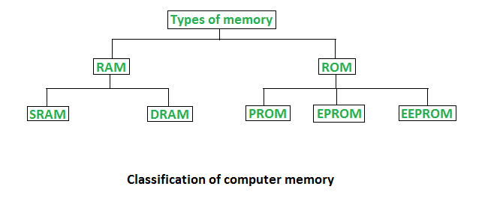

Slide 81
RAM(Random Access Memory)
RAM (Random Access Memory) is the hardware in a computing device where the operating system (OS), application programs and data in current use are kept so they can be quickly reached by the device's processor. RAM is the main memory in a computer, and it is much faster to read from and write to than other kinds of storage, such as a hard disk drive (HDD), solid-state drive (SSD) or optical drive.
Random Access Memory is volatile. That means data is retained in RAM as long as the computer is on, but it is lost when the computer is turned off. When the computer is rebooted, the OS and other files are reloaded into RAM, usually from an HDD or SSD.

Slide 82
Function of RAM
Because of its volatility, RAM can't store permanent data. RAM can be compared to a person's short-term memory, and a hard disk drive to a person's long-term memory. Short-term memory is focused on immediate work, but it can only keep a limited number of facts in view at any one time. When a person's short-term memory fills up, it can be refreshed with facts stored in the brain's long-term memory.
A computer also works this way. If RAM fills up, the computer's processor must repeatedly go to the hard disk to overlay the old data in RAM with new data. This process slows the computer's operation.
A computer's hard disk can become completely full of data and unable to take any more, but RAM won't run out of memory. However, the combination of RAM and storage memory can be completely used up.

Slide 83
Types of RAM
RAM comes in two primary forms:
Dynamic Random Access Memory (DRAM) makes up the typical computing device's RAM and, as was previously noted, it needs that power to be on to retain stored data.
Each DRAM cell has a charge or lack of charge held in an electrical capacitor. This data must be constantly refreshed with an electronic charge every few milliseconds to compensate for leaks from the capacitator. A transistor serves as a gate, determining whether a capacitor's value can be read or written.
Static Random Access Memory (SRAM) also needs constant power to hold on to data, but it doesn't need to be continually refreshed the way DRAM does.
In SRAM, instead of a capacitor holding the charge, the transistor acts as a switch, with one position serving as 1 and the other position as 0. Static RAM requires several transistors to retain one bit of data compared to dynamic RAM which needs only one transistor per bit. As a result, SRAM chips are much larger and more expensive than an equivalent amount of DRAM.
However, SRAM is significantly faster and uses less power than DRAM. The price and speed differences mean static RAM is mainly used in small amounts as cache memory inside a computer's processor.

Slide 84
ROM(Read Only Memory)
Read-only memory (ROM) is a type of storage medium that permanently stores data on personal computers (PCs) and other electronic devices. It contains the programming needed to start a PC, which is essential for boot-up; it performs major input/output tasks and holds programs or software instructions.
Because ROM is read-only, it cannot be changed; it is permanent and non-volatile, meaning it also holds its memory even when power is removed. By contrast, random access memory (RAM) is volatile, it is lost when power is removed.
There are numerous ROM chips located on the motherboard and a few on expansion boards. The chips are essential for the basic input/output system (BIOS), boot up, reading and writing to peripheral devices, basic data management and the software for basic processes for certain utilities.

Slide 85
Functions of ROM
The primary function of the ROM is data storage. Any information stored in a ROM chip can only be read and can hardly be edited, but the good news is that data will be intact even after switching off the device or when the power supply is disconnected unexpectedly.
According to computer experts, ROM stores crucial programs needed during booting.
In a nutshell, Read-only Memory (ROM) store important information that controls your computer’s basic functionality like starting up, operating the computer fan and detecting peripherals.
The user or the system cannot edit the data and unlike RAM, the content stays recorded even after switching off the computer. Most importantly, ROM is an example of non-volatile memory just like flash memory and hard drives.

Slide 86
Types of ROM
ROM: Classic or “mask-programmed” ROM chips contain integrated circuits. A ROM chip sends a current through a specific input-output pathway determined by the location of fuses among the rows and columns on the chip. The current can only travel along a fuse-enabled pathway and thus can only return via the output the manufacturer chooses. Rewiring is functionally impossible, and so there’s no way to modify these types of ROM chips. While producing a template for an original ROM chip is laborious, chips made according to an existing template can be much more affordable.
PROM: Programmable ROM, or PROM, is essentially a blank version of ROM that you can purchase and program once with the help of a special tool called a programmer. A blank PROM chip allows current to run through all possible pathways; the programmer chooses a pathway for the current by sending a high voltage through the unwanted fuses to “burn” them out. Static electricity can create the same effect by accident, so PROMs are more vulnerable to damage than conventional ROMs.

Slide 87
EPROM: Erasable Programmable ROM chips allow you to write and rewrite them many times. These chips feature a quartz window through which a specialized EPROM programmer emits a specific frequency of ultraviolet light. This light burns out all the tiny charges in the EPROM to reopen its circuits. This exposure effectively renders the chip blank again, after which you can reprogram it according to the same process as a PROM. EPROM chips will eventually wear out, but they frequently have lifetimes of over 1000 erasures.
EEPROM: To modify an Electrically Erasable Programmable ROM chip, apply localized electrical fields to erase and rewrite the data. EEPROMs have several advantages over other types of ROM. Unlike the earlier forms, you can rewrite EEPROM without dedicated equipment, without removing it from the hardware, and in specifically designated increments. You don’t have to erase and rewrite everything to make a single edit.

Slide 88
UNIT IV

Slide 89
General Register based CPU Organisation
When we are using multiple general purpose registers, instead of single accumulator register, in the CPU Organization then this type of organization is known as General register based CPU Organization. In this type of organization, computer uses two or three address fields in their instruction format. Each address field may specify a general register or a memory word.If many CPU registers are available for heavily used variables and intermediate results, we can avoid memory references much of the time, thus vastly increasing program execution speed, and reducing program size.

Slide 90
Advantages and Disadvantages of General Register based CPU Organisation
The advantages of General register based CPU organization –
Efficiency of CPU increases as there are large number of registers are used in this organization.
Less memory space is used to store the program since the instructions are written in compact way.
The disadvantages of General register based CPU organization –
Care should be taken to avoid unnecessary usage of registers. Thus, compilers need to be more intelligent in this aspect.
Since large number of registers are used, thus extra cost is required in this organization.

Slide 91
Types of General Register CPU Organisation
General register CPU organisation of two type:
Register-memory reference architecture (CPU with less register)– In this organisation Source 1 is always required in register, source 2 can be present either in register or in memory.Here two address instruction format is the compatible instruction format.
Register-register reference architecture(CPU with more register)– In this organisation ALU operations are performed only on a register data. So operands are required in the register. After manipulation result is also placed in register.Here three address instruction format is the compatible instruction format.

Slide 92
Stack based CPU Organisation
The computers which use Stack-based CPU Organization are based on a data structure called stack. The stack is a list of data words. It uses Last In First Out (LIFO) access method which is the most popular access method in most of the CPU. A register is used to store the address of the topmost element of the stack which is known as Stack pointer (SP). In this organisation, ALU operations are performed on stack data. It means both the operands are always required on the stack. After manipulation, the result is placed in the stack.
PDP-11, Intel’s 8085 and HP 3000 are some of the examples of the stack organized computers.

Slide 93
The main two operations that are performed on the operators of the stack are Push and Pop. These two operations are performed from one end only.
Push – This operation results in inserting one operand at the top of the stack and it decrease the stack pointer register. It inserts the data word at specified address to the top of the stack.
Pop – This operation results in deleting one operand from the top of the stack and it increase the stack pointer register. It deletes the data word at the top of the stack to the specified address.

Slide 94
Advantages and Disadvantages
The advantages of Stack based CPU organization –
Efficient computation of complex arithmetic expressions.
Execution of instructions is fast because operand data are stored in consecutive memory locations.
Length of instruction is short as they do not have address field.
The disadvantages of Stack based CPU organization –
The size of the program increases.
Note:Stack based CPU organisation uses zero address instruction.

Slide 95
Single Accumulator based CPU Organisation
The computers, present in the early days of computer history, had accumulator based CPUs. In this type of CPU organization, the accumulator register is used implicitly for processing all instructions of a program and store the results into the accumulator. The instruction format that is used by this CPU Organisation is One address field. Due to this the CPU is known as One Address Machine.

Slide 96
The main points about Single Accumulator based CPU Organisation are:
In this CPU Organization, the first ALU operand is always stored into the Accumulator and the second operand is present either in Registers or in the Memory.
Accumulator is the default address thus after data manipulation the results are stored into the accumulator.
One address instruction is used in this type of organization.

Slide 97
Types of Operations in Single Accumulator based CPU Organisation
Mainly two types of operation are performed in single accumulator based CPU organization:
Data transfer operation – In this type of operation, the data is transferred from a source to a destination.
For ex: LOAD X, STORE Y
Here LOAD is memory read operation that is data is transfer from memory to accumulator and STORE is memory
write operation that is data is transfer from accumulator to memory.
ALU operation – In this type of operation, arithmetic operations are performed on the data.
For ex: MULT X
where X is the address of the operand. The MULT instruction in this example performs the operation,
AC <-- AC * M[X]
AC is the Accumulator and M[X] is the memory word located at location X.
This type of CPU organization is first used in PDP-8 processor and is used for process control and laboratory applications. It has been totally replaced by the introduction of the new general register based CPU.

Slide 98
Advantages and Disadvantages
Advantages –
One of the operands is always held by the accumulator register. This results in short instructions and less memory space.
Instruction cycle takes less time because it saves time in instruction fetching from memory.
Disadvantages –
When complex expressions are computed, program size increases due to the usage of many short instructions to execute it. Thus memory size increases.
As the number of instructions increases for a program, the execution time increases.

Slide 99
INSTRUCTION FORMATS
Computer perform task on the basis of instruction provided. A instruction in computer comprises of groups called fields. These field contains different information as for computers every thing is in 0 and 1 so each field has different significance on the basis of which a CPU decide what so perform. The most common fields are:
Operation field which specifies the operation to be performed like addition.
Address field which contain the location of operand, i.e., register or memory location.
Mode field which specifies how operand is to be founded.
A instruction is of various length depending upon the number of addresses it contain. Generally CPU organization are of three types on the basis of number of address fields:
Single Accumulator organization
General register organization
Stack organization
In first organization operation is done involving a special register called accumulator. In second on multiple registers are used for the computation purpose. In third organization the work on stack basis operation due to which it does not contain any address field. It is not necessary that only a single organization is applied a blend of various organization is mostly what we see generally.

Slide 100

1.ZERO ADDRESS INSTRUCTION SET
We will use X = (A+B)*(C+D) expression to
showcase the procedure.

Slide 101
Procedure Mechanism
A stack based computer do not use address field in instruction.To evaluate a expression first it is converted to revere Polish Notation i.e. Post fix Notation.
Expression: X = (A+B)*(C+D)
Postfixed : X = AB+CD+*
TOP means top of stack
M[X] is any memory location
PUSH A TOP = A
PUSH B TOP = B
ADD TOP = A+B
PUSH C TOP = C
PUSH D TOP = D
ADD TOP = C+D
MUL TOP = (C+D)*(A+B)
POP X M[X] = TOP

Slide 102

2.ONE ADDRESS INSTRUCTIONS SET
One Address Instructions – This use a implied ACCUMULATOR register for data manipulation.One operand is in accumulator and other is in register or memory location.Implied means that the CPU already know that one operand is in accumulator so there is no need to specify it.

Slide 103
Expression: X = (A+B)*(C+D)
AC is accumulator
M[] is any memory location
M[T] is temporary location
LOAD A AC = M[A]
ADD B AC = AC + M[B]
STORE T M[T] = AC
LOAD C AC = M[C]
ADD D AC = AC + M[D]
MUL T AC = AC * M[T]
STORE X M[X] = AC

Slide 104

3.TWO ADDRESS INSTRUCTION SET
Two Address Instructions – This is common in commercial computers. Here two address can be specified in the instruction. Unlike earlier in one address instruction the result was stored in accumulator here result cab be stored at different location rather than just accumulator, but require more number of bit to represent address.
Here destination address can also contain operand.

Slide 105
Expression: X = (A+B)*(C+D)
R1, R2 are registers
M[] is any memory location
MOV R1, A R1 = M[A]
ADD R1, B R1 = R1 + M[B]
MOV R2, C R2 = C
ADD R2, D R2 = R2 + D
MUL R1, R2 R1 = R1 * R2
MOV X, R1 M[X] = R1

Slide 106

4.THREE ADDRESS INSTRUCTION SET
Three Address Instructions – This has three address field to specify a register or a memory location. Program created are much short in size but number of bits per instruction increase. These instructions make creation of program much easier but it does not mean that program will run much faster because now instruction only contain more information but each micro operation (changing content of register, loading address in address bus etc.) will be performed in one cycle only.

Slide 107
Expression: X = (A+B)*(C+D)
R1, R2 are registers
M[] is any memory location
ADD R1, A, B R1 = M[A] + M[B]
ADD R2, C, D R2 = M[C] + M[D]
MUL X, R1, R2 M[X] = R1 * R2

Slide 108
ADDRESSING MODES
Addressing Modes– The term addressing modes refers to the way in which the operand of an instruction is specified. The addressing mode specifies a rule for interpreting or modifying the address field of the instruction before the operand is actually executed.

Slide 109
TYPES OF ADDRESSING MODES
Implied / Implicit Addressing Mode
Stack Addressing Mode
Immediate Addressing Mode
Direct Addressing Mode
Indirect Addressing Mode
Register Direct Addressing Mode
Register Indirect Addressing Mode
Relative Addressing Mode
Indexed Addressing Mode
Base Register Addressing Mode
Auto-Increment Addressing Mode
Auto-Decrement Addressing Mode

Slide 110
1.IMPLIED ADDRESSING MODE
1. Implied Addressing Mode-
In this addressing mode,
The definition of the instruction itself specify the operands implicitly.
It is also called as implicit addressing mode.
Examples-
The instruction “Complement Accumulator” is an implied mode instruction.
In a stack organized computer, Zero Address Instructions are implied mode
instructions. (since operands are always implied to be present on the top of the stack)

Slide 111
2.STACK ADDRESSING MODE
2. Stack Addressing Mode-
In this addressing mode,
The operand is contained at the top of the stack.
Example-
ADD
This instruction simply pops out two symbols contained at the top of the stack.
The addition of those two operands is performed.
The result so obtained after addition is pushed again at the top of the stack.

Slide 112

3.IMMEDIATE ADDRESSING MODE
3. Immediate Addressing Mode-
In this addressing mode,
The operand is specified in the instruction explicitly.
Instead of address field, an operand field is present that contains the operand.
Examples-
ADD 10 will increment the value stored in the accumulator by 10.
MOV R #20 initializes register R to a constant value 20.

Slide 113

4.DIRECT ADDRESSING NODE
4. Direct Addressing Mode-
In this addressing mode,
The address field of the instruction contains the effective address of the operand.
Only one reference to memory is required to fetch the operand.
It is also called as absolute addressing mode.
Example-
ADD X will increment the value stored in the accumulator by the value stored at memory location X.
AC ← AC + [X]

Slide 114
5. INDIRECT ADDRESSING MODE
5. Indirect Addressing Mode-
In this addressing mode,
The address field of the instruction specifies the address of memory location that contains the effective address of the operand.
Two references to memory are required to fetch the operand.

Slide 115
UNIT - 5

Slide 116
Instruction Word Format
An instruction is normally made up of a combination of an operation code and some way of specifying an operand, most commonly by its location or address in memory though non memory reference instructions can exist. Some operation codes deal with more than one operand; the locations of these operands may be specified using any of the many addressing schemes.

Slide 117
A instruction is of various length depending upon the number of addresses it contain. Generally CPU organization are of three types on the basis of number of address fields:
Single Accumulator organization
General register organization
Stack organization
In first organization operation is done involving a special register called accumulator. In second on multiple registers are used for the computation purpose. In third organization the work on stack basis operation due to which it does not contain any address field.

Slide 118
Zero Address Instructions – A stack based computer do not use address field in instruction . To evaluate a expression first it is converted to revere Polish Notation i.e. Post fix Notation.
One Address Instructions – This use a implied ACCUMULATOR register for data manipulation . One operand is in accumulator and other is in register or memory location. Implied means that the CPU already know that one operand is in accumulator so there is no need to specify it.
Two Address Instructions – This is common in commercial computers . Here two address can be specified in the instruction . Unlike earlier in one address instruction the result was stored in accumulator here result cab be stored at different location rather than just accumulator, but require more number of bit to represent address.

Slide 119
Fetch and Execution Cycle
The fetch execute cycle is the basic operation (instruction) cycle of a computer (also known as the fetch decode execute cycle).
During the fetch execute cycle, the computer retrieves a program instruction from its memory. It then establishes and carries out the actions that are required for that instruction.
The cycle of fetching, decoding, and executing an instruction is continually repeated by the CPU whilst the computer is turned on.

Slide 120
Step | Fetch execute cycle steps | Simplified description
1 | The PC contains the address of the memory location that has the next instruction which has to be fetched | PC has address of next instruction
2 | This address is then copied from the PC to the MAR via the address bus | PC copied to the MAR
3 | The contents (instruction) at the memory location (address) contained in MAR are then copied into the MDR | Lookup MAR and get contents. Copy contents into the MDR
4 | The contents (instruction) in the MDR is then copied and placed into the CIR | Copy MDR contents into the CIR
5 | The value in the PC is then incremented by 1 so that it now points to the next instruction which has to be fetched | PC is then incremented by 1
6 | The instruction is finally decoded and then executed by sending out signals (via control bus) to the various components of the computer | The instruction is decoded and then executed
7 | Repeat

Slide 121

Sequence Of Operation Of
Control Registers

Slide 122
Control Of Arithmetic Operations
Arithmetic Logical Unit is the part of control processing unit that controls the arithmetic operations. It is the function of Arithmetic logical unit to check for the arithmetic and logical operations.
The inputs to an ALU are the data to be operated on, called operands, and a code indicating the operation to be performed; the ALU's output is the result of the performed operation. In many designs, the ALU also has status inputs or outputs, or both, which convey information about a previous operation or the current operation, respectively, between the ALU and external status registers.

Slide 123
An ALU has a variety of input and output nets, which are the electrical conductors used to convey digital signals between the ALU and external circuitry. When an ALU is operating, external circuits apply signals to the ALU inputs and, in response, the ALU produces and conveys signals to external circuitry via its outputs.
Data
A basic ALU has three parallel data buses consisting of two input operands (A and B) and a result output (Y). Each data bus is a group of signals that conveys one binary integer number. Typically, the A, B and Y bus widths (the number of signals comprising each bus) are identical and match the native word size of the external circuitry (e.g., the encapsulating CPU or other processor).

Slide 124

Opcode
The opcode input is a parallel bus that conveys to the ALU an operation selection code, which is an enumerated value that specifies the desired arithmetic or logic operation to be performed by the ALU. The opcode size (its bus width) determines the maximum number of different operations the ALU can perform; for example, a four-bit opcode can specify up to sixteen different ALU operations. Generally, an ALU opcode is not the same as a machine language opcode, though in some cases it may be directly encoded as a bit field within a machine language opcode.

Slide 125
Microprogramming Concepts
Micro-programmed Control Unit –
The control signals associated with operations are stored in special memory units inaccessible by the programmer as Control Words.
Control signals are generated by a program are similar to machine language programs.
Micro-programmed control unit is slower in speed because of the time it takes to fetch microinstructions from the control memory.

Slide 126
Some Important Terms –
Control Word : A control word is a word whose individual bits represent various control signals.
Micro-routine : A sequence of control words corresponding to the control sequence of a machine instruction constitutes the micro-routine for that instruction.
Micro-instruction : Individual control words in this micro-routine are referred to as microinstructions.
Micro-program : A sequence of micro-instructions is called a micro-program, which is stored in a ROM or RAM called a Control Memory (CM).
Control Store : the micro-routines for all instructions in the instruction set of a computer are stored in a special memory called the Control Store.

Slide 127

Microprogram Unit

Slide 128
PRESENTED BY:- AJITESH MISHRA
MCA(III SEM) SEC A
PRESENTED TO:- SHALIGRAM PRAJAPATI SIR

